Slide 1
05. 클래스와 객체

Slide 2
실습내용
Practice #5: Learn Strings and Vectors & Improve Grade Management Program #4
  Modify only the following parts of the previous grade management program.
  Filename: PracticeAssignment#5_2022199002_HongGilDong
  Learn about string, vector, and class.
  Modify the program so that the number of students and subjects can be input dynamically instead of being fixed to 2 students and 3 subjects (use dynamic allocation with structs).
  Modularize the input part for student profile and grade information using functions.

Slide 3
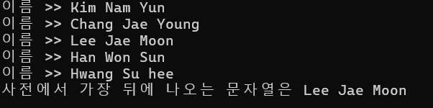
Practice #5-1: string (1)
Declare an array of 5 strings, use getline() to input each, and print the string that comes last in dictionary order. Use < and > operators for string comparison
<실행 예시>

Slide 4
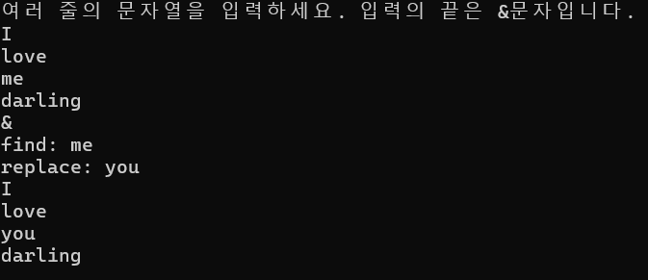
실습#5-1 : string (2)
Keep inputting multiple lines of text until & is entered. Then input a search string and a replacement string. Replace all occurrences of the search string with the replacement string and output the result.
Hint: Use .pop_back(), .length(), .replace() from the string class.
#include <iostream>
#include <string>
using namespace std;
int main() {
string s;
cout<< "여러 줄의 문자열을 입력하세요. 입력의 끝은 &문자입니다." << endl;
cout<< s << endl;
}

Slide 5
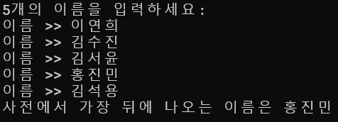
실습#5-1 : vector
Use vector<string> to store 5 names.
Print the name that comes last in dictionary order.
vector<string>
<실행 예시>

Slide 6

실습#5-1 : 클래스
Complete the Rectangle class so that the following main function works:
int main() {
Rectangle rect;
rect.width = 3;
rect.height = 5;
cout << "사각형의 면적은 " << rect.getArea() << endl;
}

Slide 7
실습#5-2 : 성적처리프로그램#5(1)
Requirements
Declare student and subject structs using pointer variables so that the number of students and subjects can be set dynamically.
Use new and delete operators to dynamically allocate Student and Subject structures.
  Receive number of students and subjects from the user.
  Structs must be declared using pointers to use dynamic allocation.
Add an int SubNum; variable to the Student struct to store the number of subjects.
함수 사용 예 | int StdNum; // 전체 학생 수 cin >> StdNum; // StdNum == 2 Student* St = new Student[StdNum]; InputData(St, StdNum);
struct Student {// 학생 정보
char StdName[30]; // 학생 이름
int Hakbun; // 학번
Subject *Sub; // 과목
int SubNum; // 과목 수
float AveGPA; // 교과목 평균 평점
};

Slide 8
실습#5-2 : 성적처리프로그램#5(2)
Requirements
4. Add an InputData() function that takes care of inputting student profile and grade data. The program must be able to execute the "menu option #1" functionality.
함수의 프로토타입 | void InputData(Student *pSt, int StudentNum); // pSt : 수정할 학생정보 포인터 매개변수 // StudentNum : 전체 학생 수

